Slide 1
Wireless Sensor Networks

Slide 2
Outline
Overview
Environment Monitoring
Medical application
Data-dissemination schemes
Media access control schemes
Distributed algorithms for collaborative processing
Architecture for a Wireless Sensor Network
Final Remarks

Slide 3
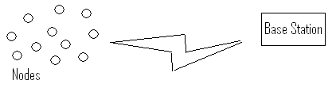
Overview
A Wireless Sensor Network (WSN) consists of base stations and a number of wireless sensors (nodes).

Slide 4
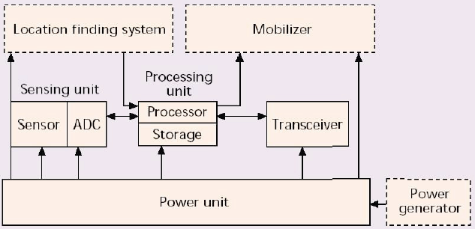
Overview (Cont.)
Wireless Sensor Node: Components
Notes:
ADC - Analog-Digital Converter

Slide 5
Overview (Cont.)
Characteristics of Wireless Sensor Networks
Requirements: small size, large number, tether-less, and low cost. Constrained by
Energy, computation, and communication
Small size implies small battery
Low cost & energy implies low power CPU, radio with minimum bandwidth and range
Ad-hoc deployment implies no maintenance or battery replacement
To increase network lifetime, no raw data is transmitted

Slide 6
Overview (Cont.)
Ad Hoc Wireless Networks
Large number of self-organizing static or mobile nodes that are possibly randomly deployed
Near(est)-neighbor communication
Wireless connections
Links are fragile, possibly asymmetric
Connectivity depends on power levels and fading
Interference is high for omnidirectional antennas
Sensor Networks and Sensor-Actuator Networks are a prominent example.

Slide 7
Overview (Cont.)
Distinguishing Features
WSNs are ad hoc networks (wireless nodes that self-organize into an infrastructureless network).
BUT, in contrast to other ad hoc networks:
Sensing and data processing are essential
WSNs have many more nodes and are more densely deployed
Hardware must be cheap; nodes are more prone to failures
WSNs operate under very strict energy constraints
WSN nodes are typically static
The communication scheme is many-to-one (data collected at a base station) rather than peer-to-peer

Slide 8
Overview (Cont.)
Lifetime
Nodes are battery-powered
Nobody is going to change the batteries. So, each operation brings the node closer to death.
"Lifetime is crucial!”
To save energy:
Sleep as much as possible.
Acquire data only if indispensable.
Use data fusion and compression.
Transmit and receive only if necessary. Receiving is just as costly as sending.

Slide 9
Overview (Cont.)
Scalability and Reliability
WSNs should
self-configure and be robust to topology changes (e.g., death of a node)
maintain connectivity: can the Base Station reach all nodes?
ensure coverage: are we able to observe all phenomena of interest?
Maintenance
Reprogramming is the only practical kind of maintenance.
It is highly desirable to reprogram wirelessly.

Slide 10
Overview (Cont.)
Data Collection
Centralized data collection puts extra burden on nodes close to the base station. Clever routing can alleviate that problem
Clustering: data from groups of nodes are fused before being transmitted, so that fewer transmissions are needed
Often getting measurements from a particular area is more important than getting data from each node
Security and authenticity should be guaranteed. However, the CPUs on the sensing nodes cannot handle fancy encryption schemes.

Slide 11
Overview (Cont.)
Power Supply
AA batteries power the vast majority of existing platforms. They dominate the node size.
Alkaline batteries offer a high energy density at a cheap price. The discharge curve is far from flat, though.
Lithium coin cells are more compact and boast a flat discharge curve.
Rechargeable batteries: Who does the recharging?
Solar cells are an option for some applications.
Fuel cells may be an alternative in the future.
Energy scavenging techniques are a hot research topic (mechanical, thermodynamical, electromagnetic).

Slide 12
Overview (Cont.)
Radio
Commercially-available chips
Available bands: 433 and 916MHz, 2.4GHz ISM bands
Typical transmit power: 0dBm.
Power control
Sensitivity: as low as -110dBm
Narrowband (FSK) or Spread Spectrum communication. DS-SS (e.g., ZigBee) or FH-SS (e.g., Bluetooth)
Relatively low rates (<100 kbps) save power.
Notes:
industrial, scientific and medical (ISM) : http://en.wikipedia.org/wiki/ISM_band

Slide 13
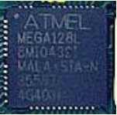

Overview (Cont.)
CPU
The Microcontroller Unit (MCU) is the primary choice for in-node processing.
Power consumption is the key metric in MCU selection.
The MCU should be able to sleep whenever possible, like the radio.
Memory requirements depend on the application
ATmega128L and MSP430 are popular choices
Notes:
A microcontroller unit (MCU) is an integrated circuit (IC) that contains many of the functions found in a typical computer system. A microcontroller uses a microprocessor as its central processing unit and incorporates features such as memory, a timing reference, and input/output peripherals, all on the same chip.

Slide 14
Overview (Cont.)
Sensors
The power efficiency of the sensors is also crucial, as well as their duty cycle.
MEMS techniques allow miniaturization.
Notes:
Micro-Electro-Mechanical Systems (MEMS) is the integration of mechanical elements, sensors, actuators, and electronics on a common silicon substrate through microfabrication technology.

Slide 15
Overview (Cont.)
Applications of Wireless Sensor Networks
Military and national security application
Environment monitoring (examples coming)
Medical application (example coming)
Nearly anything you can imagine

Slide 16
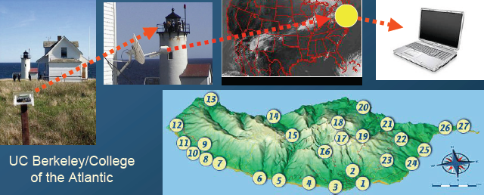
Environment monitoring (1)
Great Duck Island
150 sensing nodes deployed throughout the island relay data temperature, pressure, and humidity to a central device.
Data was made available on the Internet through a satellite link.

Slide 17
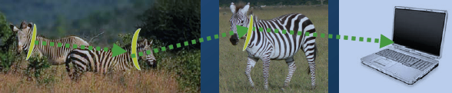
Environment monitoring (2)
Zebranet: a WSN to study the behavior of zebras
Special GPS-equipped collars were attached to zebras
• Data exchanged with peer-to-peer info swaps
• Coming across a few zebras gives access to the data

Slide 18
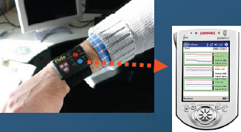
Medical application
• Vital sign monitoring
• Accident recognition
• Monitoring the elderly
Intel deployed a 130-node network to monitor the activity of residents in an elder care facility.
Patient data is acquired with wearable sensing nodes (the “watch”)

Slide 19
Data-dissemination Schemes
Conventional Methods
Direct communication with the base station
Sensor nodes communicate with the base station directly.
Energy consuming.
Multi-hop Scheme
Transmit through some other intermediate nodes.
Energy consuming.

Slide 20
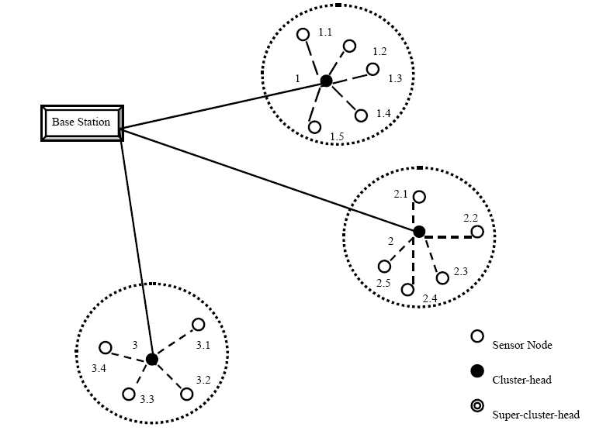
Clustering Hierarchy
Data-dissemination Schemes (Cont.)

Slide 21
Low Energy Adaptive Clustering Hierarchy (LEACH)
Data-dissemination Schemes (Cont.)
Designed for sensor networks where an end-user wants to remotely monitor the environment. Where the data from the individual nodes must be sent to a central base station, often located far from the sensor network.
Desirable properties for protocols on these networks:
Use 100’s – 1000’s of nodes
Maximize system lifetime
Maximize network coverage
Use uniform, battery operated nodes
The use of distributed cluster formation and local processing to reduce global communication along with randomized rotation of the cluster-heads allows LEACH to achieve the desired properties while being energy-efficient.

Slide 22
Media Access Control (MAC) Scheme
Two categories of MAC schemes for wireless networks
Contention-based schemes
Designed for minimum delay and maximum throughput.
Require transceivers to monitor the channel at all times.
Reservation-based or schedule-based schemes
Detect the neighboring radios before allocating collision-free channel to a link.
TDMA —a natural choice for sensor networks.

Slide 23
MAC Scheme (Cont.)
TDMA-based solutions
The self-organizing “super frame” algorithm
Super frame = TDMA period + BOOTUP period + unused bandwidth
Performs well only under the specific conditions.
Power Aware Clustered TDMA (PACT)
Divide the TDMA structure into control slot and data slot.
Hard to maintain the cluster when there are mobile nodes.

Slide 24
MAC Scheme (Cont.)
Other solutions
Sensor-MAC (SMAC)
Nodes periodically sleep.
A node sleeps during transmission period of other nodes.
Not suitable for time-critical applications.

Slide 25
Architecture for a WSN
Special addressing requirement
Local unique addresses
Data-centric
Example: Each node has an unique number.
Attribute-based naming architecture
Data is named by one or more attributes.
Example: Each node is distinguished by an attribute – GPS sensors are practical for this.

Slide 26
Architecture for a WSN (cont.)
An address-free architecture (AFA)
Advantage
Randomly select probabilistically unique identifier for each transaction.
Spatial locality.
Temporal locality.
Drawback
Not applicable when static addressing of nodes is needed.
Identifier conflict.

Slide 27
Final Remarks
Can you think of any applications where a wireless sensor network would be the best solution?
Do you foresee wireless sensor networks becoming ubiquitous within the next ten years? During your lifetime?

